Slide 1
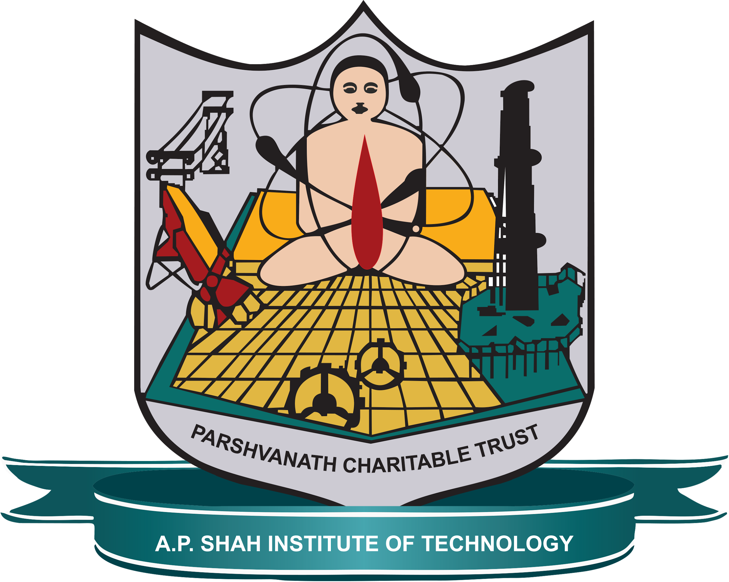
Computer Engineering Department A.P. Shah Institute of Technology G.B.Road,Kasarvadavli, Thane(W), Mumbai-400615 UNIVERSITY OF MUMBAI Academic Year 2020-2021

Slide 2
A presentation on AI Audiobook Submitted in partial fulfillment of the degree of Bachelor of Engineering(Sem-5) in Computer Engineering By Soumyojyoti Dutta(19102014) Vedang Gore(19102065) Sumati Hans(18102028)
Aarya Totey(19102070) Under the Guidance of Prof. Sofiya Mujawar

Slide 3
1.Project Conception and Initiation

Slide 4
1.1 Abstract
We came across the fact that reading books in the traditional way was getting very difficult with the advent of technological advancements. We thought listening to audiobooks would be a very good alternative. However, currently the apps that provide such services have a limited catalogue of books and we can not guarantee that the book that we want would be present in their collection. So we attempt to make an app that would convert the pdfs or the pictures of the book pages and convert them into audiobooks so that we can listen as much as we want and whenever we want. Our application will first take a pdf or an image file from the user using the front-end . Then by applying OCR we will convert the file to text and then we will use Machine Learning to read out the contents from the file to the user.

Slide 5
1.2 Objectives
Any people can gain knowledge by listening to audiobooks in any situation
People can listen their favourite books just by uploading them
People can listen to books of their choice if they have an image or pdf of the book.
With this knowledge can be imparted in an convenient way.
Audio books offer blind students to study more independently wherever or whenever they want without other people's help.

Slide 6
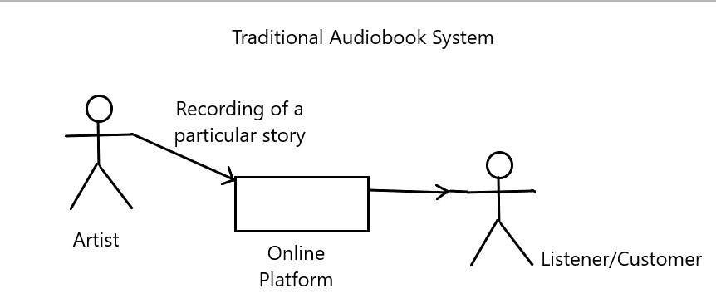
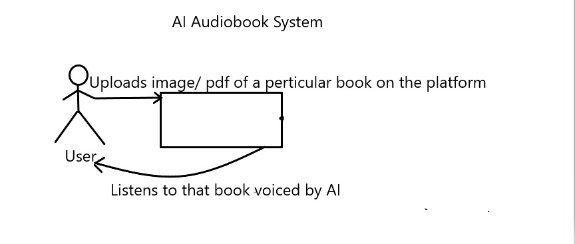
Traditional Vs Our Model

Slide 7
1.3 Literature Review:
Research paper | Author’s Name | Abstract
Text-to-speech conversion by ieee | M.H. O'Malley,Berkeley Speech Technologies, Inc., Berkeley, CA, USA | The major elements of a TTS system are described, with particular reference to vocal tract models. The stages involved in the process of converting text into speech parameters are examined, covering text normalization, word pronunciation, prosodies, phonetic rules, voice tables, and hardware implementation.
Image preprocessing by ieee | Bayin Guoleng Vocational and Technical College, Xinjiang, China | Image pre-processing and segmentation technology is one of the main object of study, this also is the current market and users of digital image using the proposed new requirements. This article mainly expounds theory of digital image pre-processing and segmentation technology, and image processing technology and the division of specific operation.
Interaction with a Mobile Reader for the Visually Impaired | Robert Keefer and Nikolaos Bourbakis | Assistive Technologies Research Center, Wright State University, 21st IEEE International Conference on Tools With Artificial Intelligence.

Slide 8
1.4 Problem Definition
Designing an AI book reader application that will read whatever the input file is given be it a pdf or an image using OCR. The app will convert pdf or pages scanned into audiobooks.

Slide 9
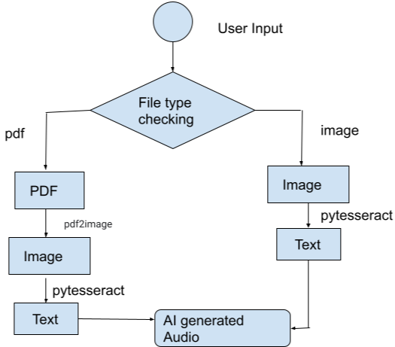
1.5 Flow of Module

Slide 10
1.5 Scope
Our application will first take a pdf or an image file from the user
If the file is a pdf then the app will convert pdf into image and then the image to text and then that text to audio respectively.
Else the image file is directly converted to text and then the text is converted to audio.
The audio can then be listened properly.

Slide 11
1.6 Technology stack
Pytesseract: Python-tesseract is an optical character recognition (OCR) tool for python. That is, it will recognize and “read” the text embedded in images. Python-tesseract is a wrapper for Google’s Tesseract-OCR Engine. It is also useful as a stand-alone invocation script to tesseract, as it can read all image types supported by the Pillow and Leptonica imaging libraries, including jpeg, png, gif, bmp, tiff, and others. Additionally, if used as a script, Python-tesseract will print the recognized text instead of writing it to a file.
OpenCV: OpenCV is the huge open-source library for the computer vision, machine learning, and image processing and now it plays a major role in real-time operation which is very important in today’s systems. By using it, one can process images and videos to identify objects, faces, or even handwriting of a human. When it integrated with various libraries, such as NumPy, python is capable of processing the OpenCV array structure for analysis. .

Slide 12
Pyttsx3: pyttsx3 is a text-to-speech conversion library in Python. Unlike alternative libraries, it works offline and is compatible with both Python 2 and 3. An application invokes the pyttsx3.init() factory function to get a reference to a pyttsx3. Engine instance. it is a very easy to use tool which converts the entered text into speech.
Visual Studio Code: Visual Studio Code is an Integrated Development Environment (IDE) made by Microsoft for Windows, Linux and macOS. Features include support for debugging, syntax highlighting, intelligent code completion, snippets, code refactoring, and embedded Git. Users can change the theme, keyboard shortcuts, preferences, and install extensions that add additional functionality.
Jupyter Notebooks: Jupyter Notebook (formerly IPython Notebooks) is a web-based interactive computational environment for creating notebook documents.A Jupyter Notebook document is a browser-based REPL containing an ordered list of input/output cells which can contain code, text (using Markdown), mathematics, plots and rich media. Underneath the interface, a notebook is a JSON document, following a versioned schema, usually ending with the ".ipynb" extension.

Slide 13
1.7 Benefits for environment & Society
Firstly, use of e-book helps us save environment as there is a significant reduction in the usage of pages required.
Continuous usage of e-books leads to eye-related problems whereas audiobook is a much better alternative.
It is easy to use and can be accessed whenever required especially in a crowd. you can listen to an audiobook easily in any environment
No need to carry and store heavy books as a single device can hold many of them!

Slide 14
1.8 Future Scope:
Replace pyttsx3 with a better AI model
Add GUI to the application
Saving and making the audio file easily traversable for user convenience
Improve the pre-processing of the files

Slide 15
Thank You

